Slide 1
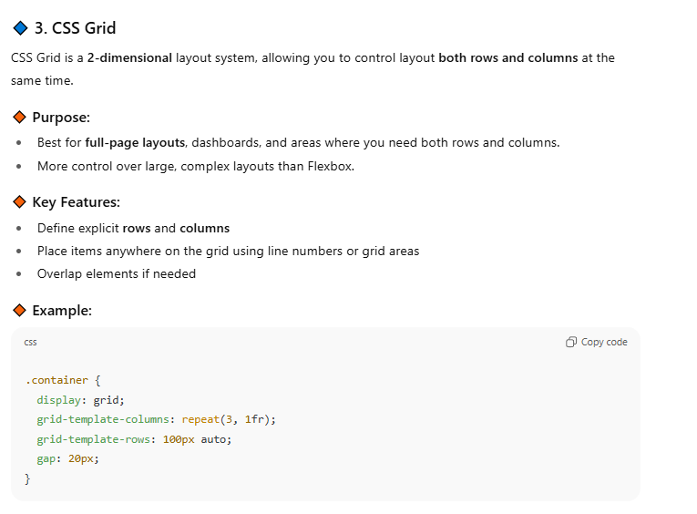
Week 11 - Css grid

Slide 2
IC11

Slide 3
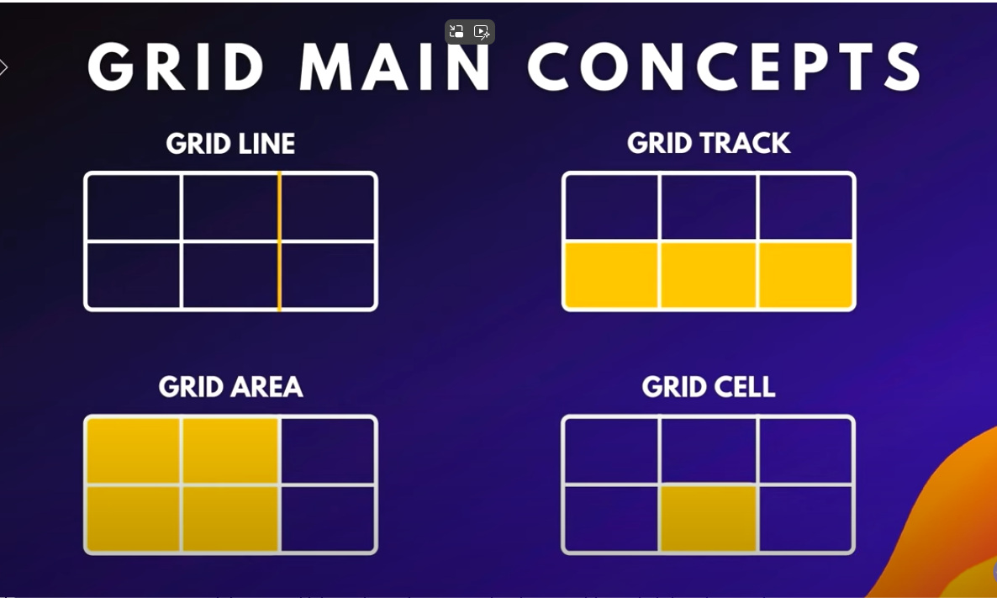

Slide 4
grid

Slide 5
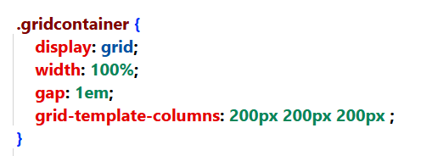
Most Basic GrID
Tells css to use grid
3 columns, each 200px
Impressive? Meh…we could do that with flexbox
In fact, there is huge overlap between flexbox and grid. There are rumours of unification in the future…

Slide 6
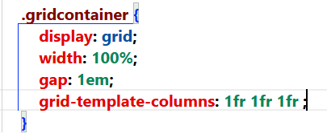
Most Basic GrID
OK, a little bit cooler
Tells css to use grid
Instead of 200px for each column, we can split them up so that they scale up and down with the viewport

Slide 7
Relative units
Unit | Relative To
em | Element’s font size
rem | Root font size (<html>)
ex | x-height of current font
ch | Width of “0” character
lh | Line-height of element
rlh | Root element line-height
% | Parent container size
fr | Used with grid – fraction of available space

Slide 8
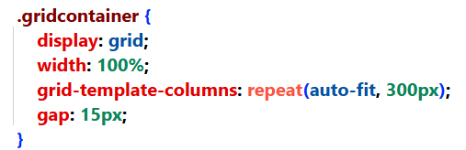
Most Basic GrID
OK, a little bit cooler
Tells css to use grid
We will autofit as many griditems as we can! Each griditem is 300px

Slide 9
yourturn1

Slide 10
Grid (span)

Slide 11
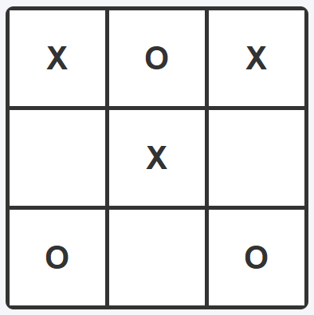
yourturn2

Slide 12
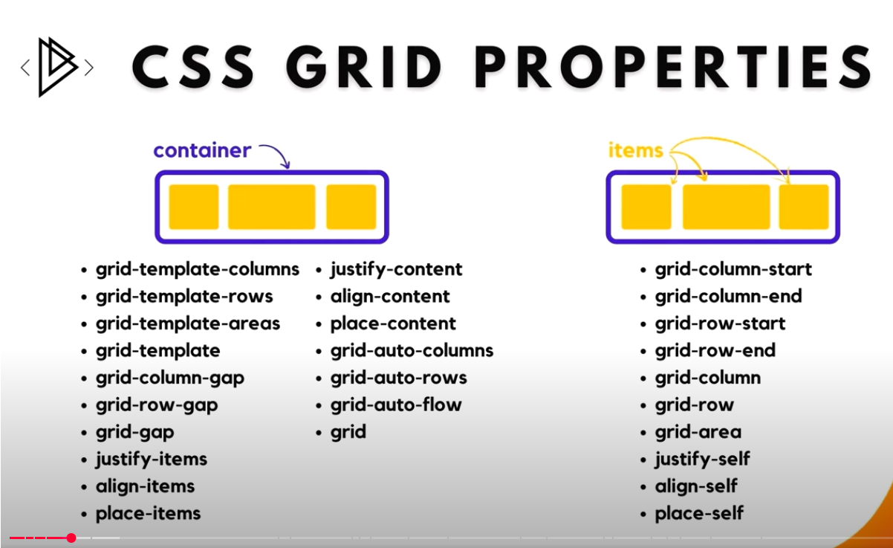

Slide 13
Gridtemplateareas

Slide 14
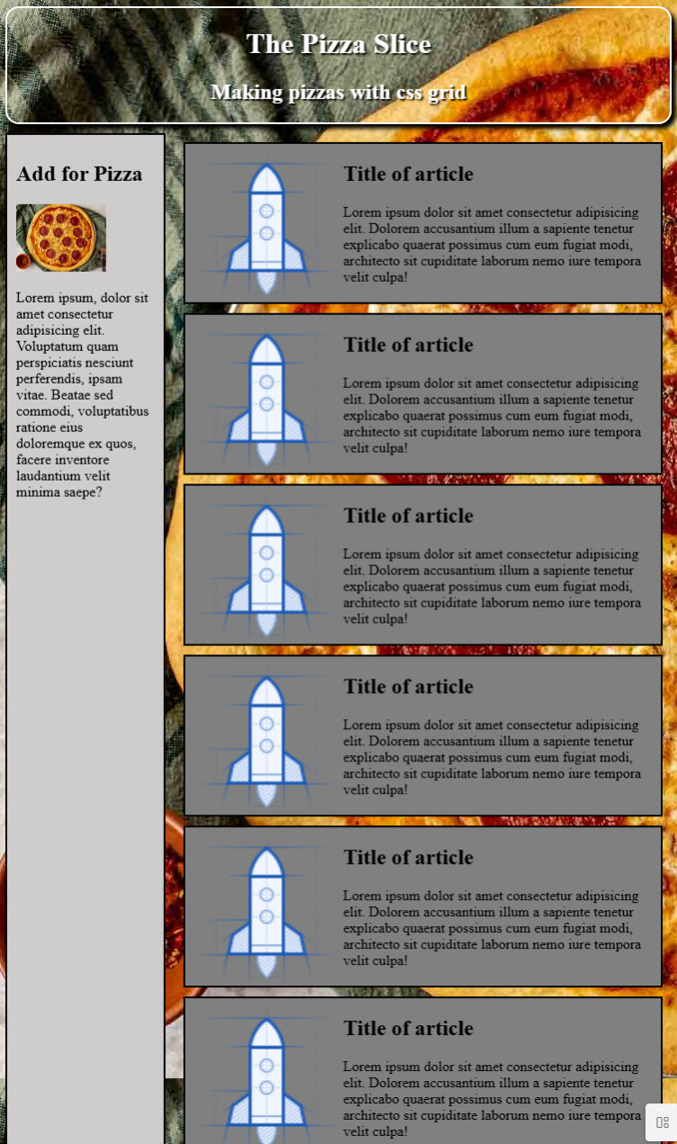
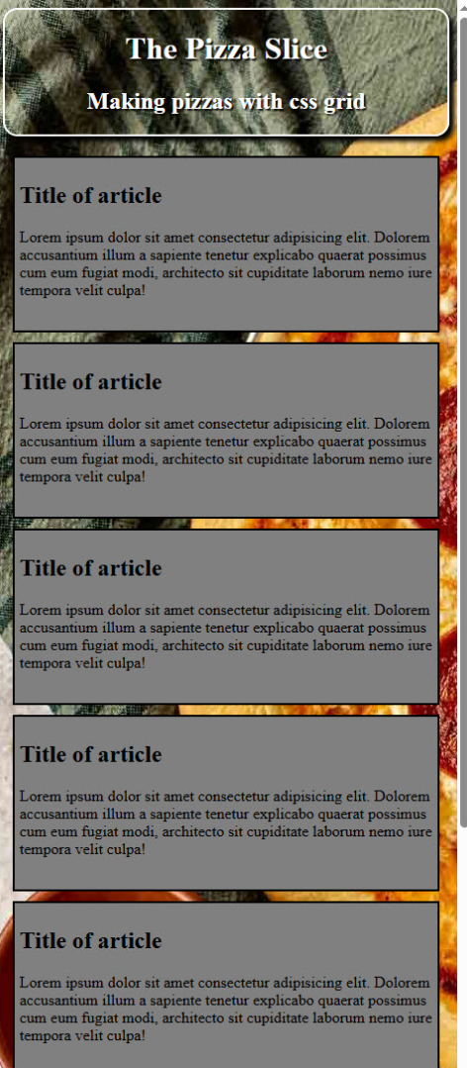
yourturn3

Slide 15
Gridtemplateareas

Slide 16
gridoverlap

Slide 17
Assignment #4
Build a resume for yourself or someone else (real, imagined, fictional) that will look good regardless of the width of the browser displaying it. Use any of the technologies that we’ve learned so far!
Your resume should have pictures, be well-formatted, and be aesthetically pleasing!
Bonus marks on the final will be given for really cool resumes!
However, use only stuff that we have learned so far!!! (as of the end of week 11.

