Slide 1
Week 4
A bit more CSS
The DOM
Using the inspect tool in your browser
How a webpage renders
Semantic and non-semantic sectioning tags

Slide 2
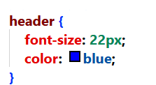
Tell me something you learned last week
Make my own
Selector
Values
Property
Ruleset

Slide 3
Assignment #1
Let’s take a look…

Slide 4
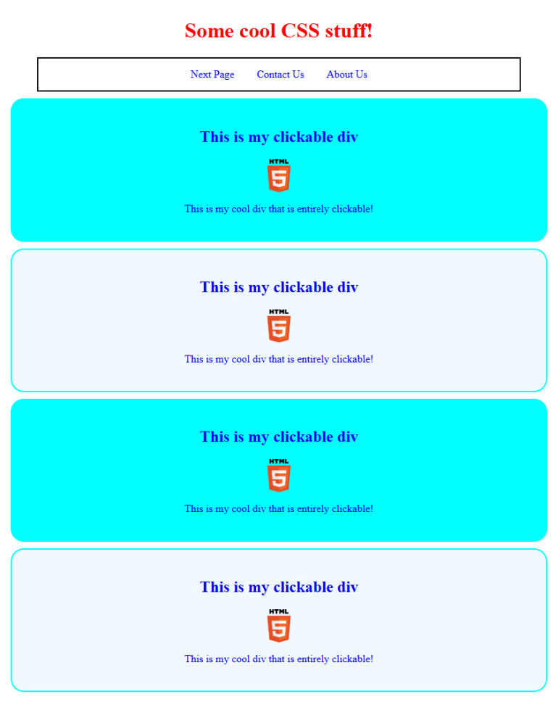
Some cool stuff
Css classes
Using anchors as containers
Some neat css directives

Slide 5
Cool css stuff

Slide 6
Work on Assignment #1 20 minutes

Slide 7
How a webpage Really renders
The browser receives HTML (delivered by HTTP)
HTML is parsed by the browser
The browser starts reading the HTML from top to bottom.
It parses tags, attributes, and text content.
DOM tree is built
As it parses, the browser creates a tree of nodes:
Element nodes for tags like <div>, <p>, etc.
Text nodes for content inside elements.
Attribute nodes for things like id="main" or class="item".

Slide 8
CSS and JS are linked in
When the parser hits a <link> or <style>, it loads and applies CSS.
Note that CSS and JS operate on the DOM, not the HTML
The HTML’s only job is to provide instructions to the parser to build the DOM
Finally, the browser renders the page, using the DOM

Slide 9
Why?
Why bother building this DOM? Can’t the browser just render the page directly?

Slide 10
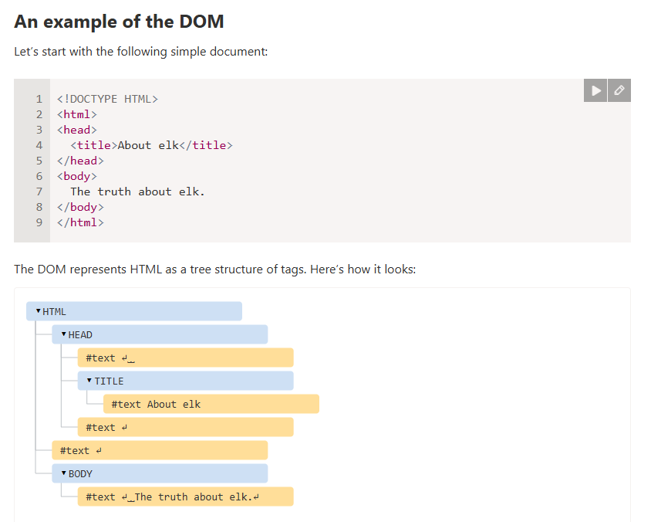
The DOM
Every element is built into an object that can be accessed programmatically.
The objects are arranged in a tree structure
We can access these objects using javascript and css

Slide 11
Dom1

Slide 12
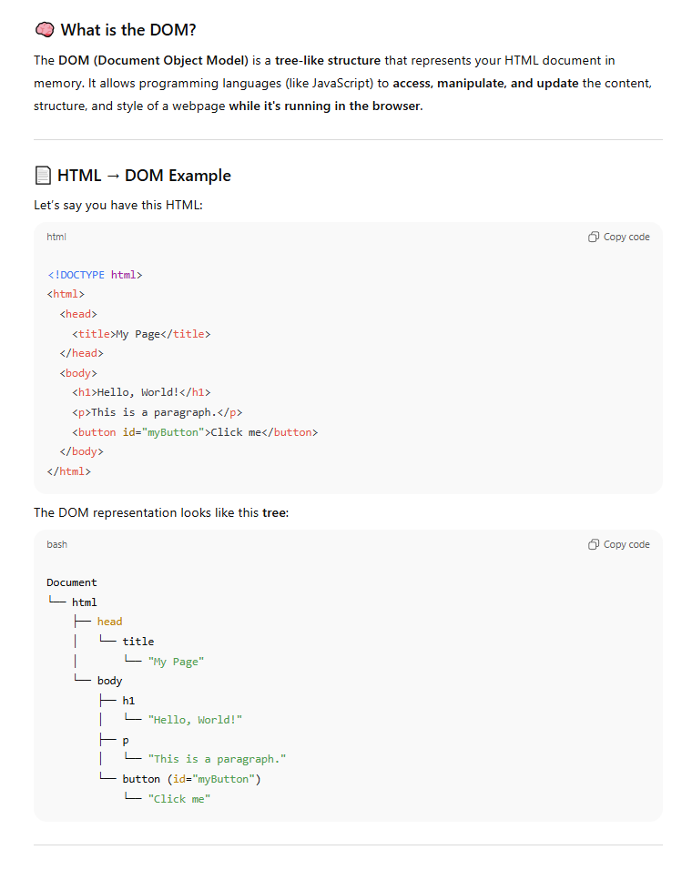

Slide 13
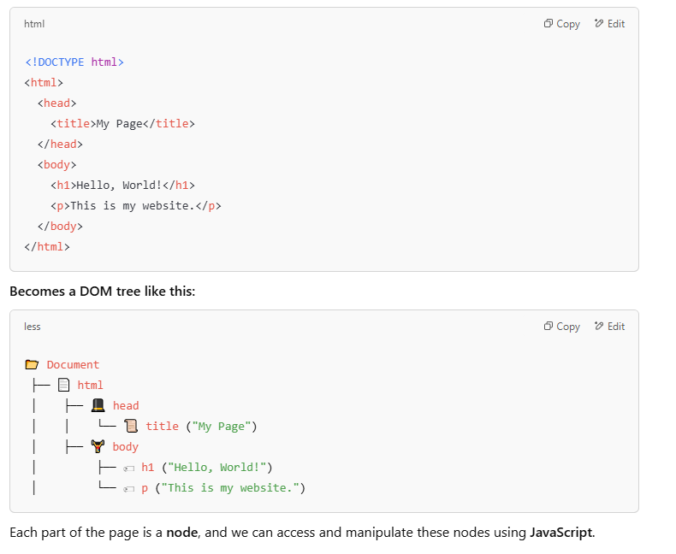
This:
Is used to build this:

Slide 14
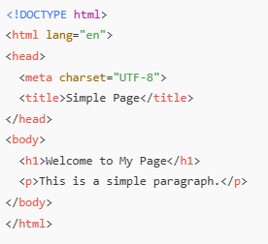
Given this HTML, pretend that you are the browser parser and build the DOM tree (feel free to do it on paper or using notepad)

Slide 15
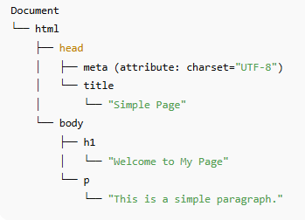
Answer

Slide 16
usinginspect

Slide 17
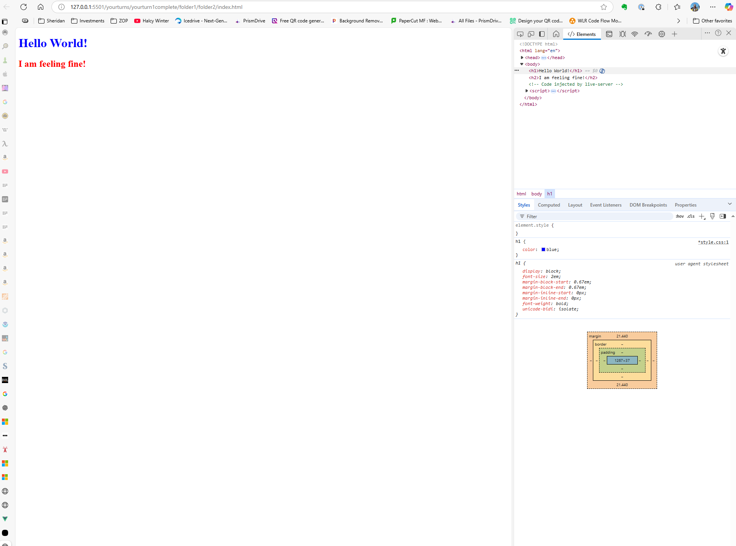
Using Inspect in our browser – A deeper dive

Slide 19
Review: Document Sectioning using semantic tags
Defines the outline of our document.
They are important for many reasons!
Screen readers
Search engine crawlers (SOE)
Organizing our information into relevant sections
A convenient way for us to use JS and CSS to make our page prettier and/or more functional

Slide 20
sections

Slide 21
Yourturn 1

Slide 22
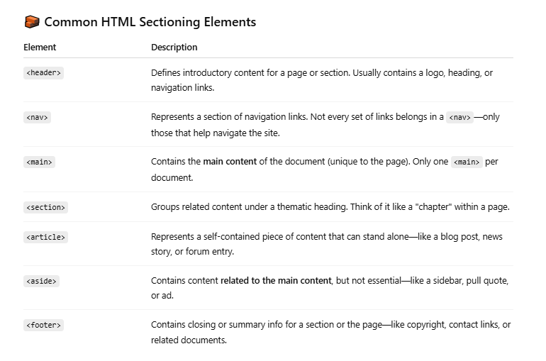

Slide 23
Assignment #1
Let’s take a look…

Slide 24
Assignment #2
Build an html page that includes any information you’d like to bring into the exam with you.
Feel free to use images, tables, and any css that we have learned so far.
Move your page onto the server and copy the link into the dropbox comments.

