Slide 1
Week 5
Lists – Tables – BlockQuotes – Menus - Figures

Slide 2
Tell me something you learned last week

Slide 3
My list of funny jokes!

Slide 4
yourturn1

Slide 5
Tables
<table> - we are about to make a table
<caption> the title of the table
<thead> - semantic tag that allows us to group headings
<tbody> - semantic tag that allows us to group table content
<tfoot> - semantic tag that allows us to identify a footer in the table
<tr> table row
<th> table heading cell
<td> ‘table data’ cell

Slide 6
Tables

Slide 7
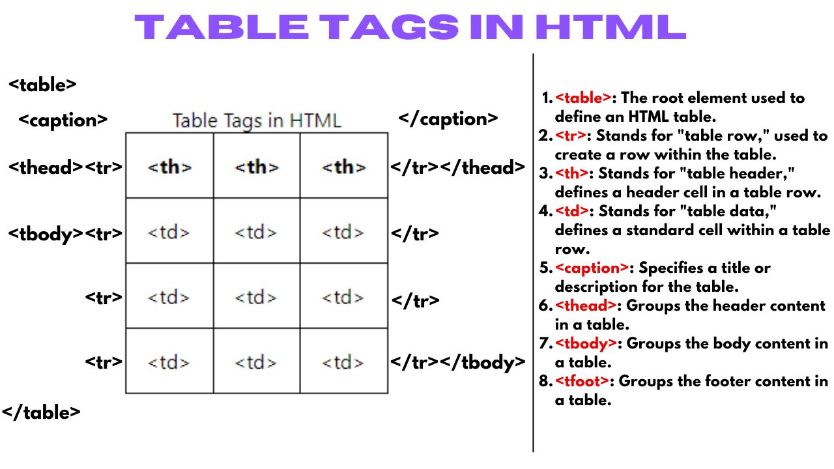

Slide 8
Table attributes
colspan, rowspan – allows spanning multiple columns and rows. We won’t need to know these for this course
Scope – use in <th> to specify whether this heading is for a row or a column.

Slide 9
Tables
Note that tables can be much more advanced than we are seeing.
Any table the you can build in Excel, can be built in html using tables.

Slide 10
yourturn2

Slide 11
menus

Slide 12
<Menu>

Slide 13
figures

Slide 14
Img, Figure, figcaption

Slide 15
blockquote

Slide 16
Yourturn 3 and IC4

