Slide 1
Review!
How to prepare:
  Make sure you know how to move your pages from your computer to your server
  Make sure you can submit the correct url!!! Test it before you submit!!!
  Read through your notes
  Look at all of your in-class assignments
  Look at your assignments

Slide 2
Think of a good exam question and post it to chat
What is the internet?!
Intro to HTML
A tiny peek into CSS - Accessibility on the web -
The DOM -Using the inspect tool in your browser = How a webpage renders
Lists and Tables
I will choose 2 of the questions for the actual exam!

Slide 3
Exam consists of
30 marks theory
  Slate Quiz
    Short answer
    Multiple choice
    Multiple select
20 marks practical
  Use VSCode to build something

Slide 4
Theory – What have we learned?
About the internet
HTML basics
Block vs inline
Accessible content
Semantic vs non-semantic
Targeting elements with selectors:
  Type, class, id, multiple, nesting
Relative vs absolute addressing
Etc.

Slide 5
Practical
You MUST know how to move your code to the Sheridan Webserver that you set up in week 1. I cannot mark your work if you don’t give me the correct url
I Guarantee that you will need to understand:
  Basic tables
  Basic css selectors
  Semantic tags
  Attributes such as
    background-color
    border, margin, padding
    Width, text-align, color,
    Box-shadow

Slide 6
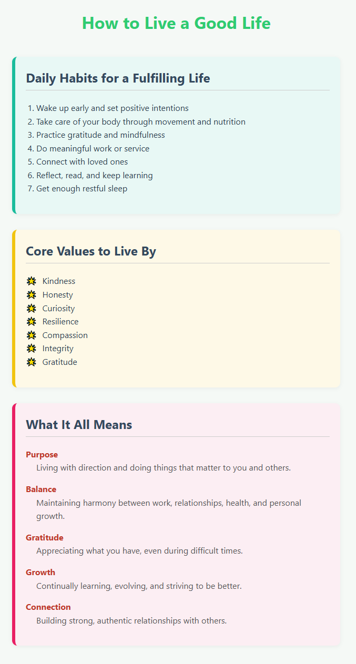
IC6 – Practice for Midterm!

