Slide 1
2nd half…CSS!
Now things get a little more interesting…

Slide 2
Rich’s Rant
CSS is changing quickly! Every time a framework does something cool, the css group thinks about how to incorporate it.
This is good because css regularly becomes more powerful and more flexible
This is bad because it doesn’t always grow smoothly
Layout, for example, is fragmented with many ways to do things.
Get used to learning new stuff…always!
We can’t possibly cover every nuance of css but we will learn the core concepts that will give you a good foundation

Slide 3
Week 8
Basic selectors review
Advanced selectors
Inheritance
Units
Specificity - How CSS cascades (Which rules win.)

Slide 4
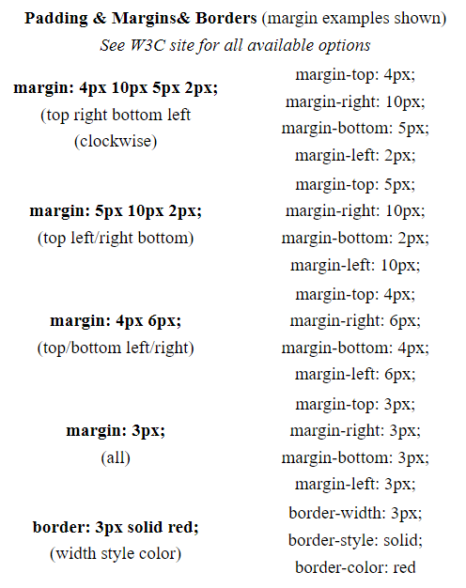
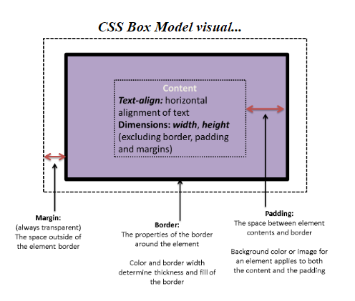
Quick Review of Box Model

Slide 5
Quick Review of Box Model and inspect
boxmodel
Basic CSS: Margins in CSS

Slide 6
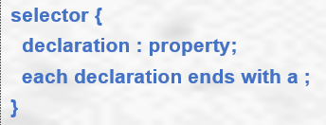
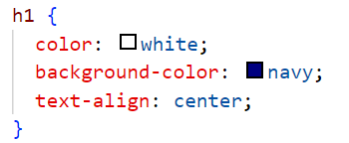
CSS Syntax
Declaration
block
Rule Set
Selector Which element is being styled
{} Declaration block
Declarations value assigned to a specific CSS property
Properties CSS standardized
See CSS reference sheet in References Module
MDN Web Docs - Standard CSS Properties Complete
Values - Also CSS standardized

Slide 7
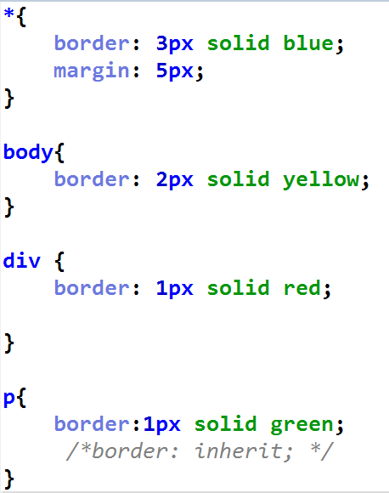
Pop Quiz!
What is this?
Rule Set
Selector
Declaration Block
Declaration
Comment

Slide 8
Basic Selectors

Slide 9
Basic ways to target content
By universal tag (*)
Element Selector (by html tag)
Tag name Ex: div { color: blue; }
Classes
Class name preceded by a period (.) Ex: .subtitle { color: blue; }
ID
ID name Ex: #redLine { color: red; }

Slide 10
Combinator Selectors
selectors

Slide 11
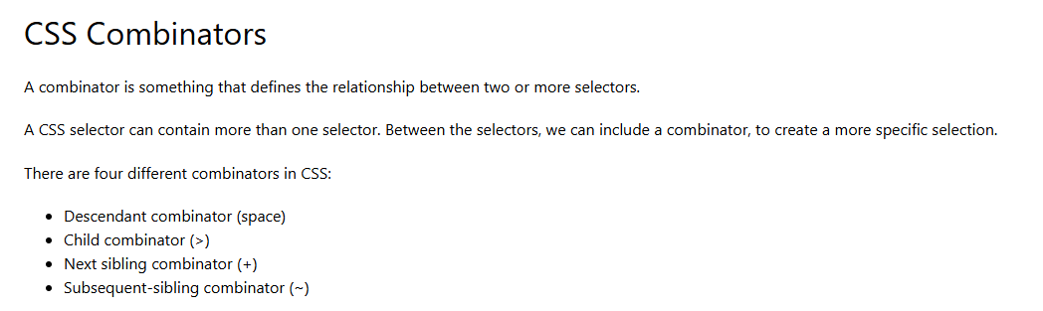
Combinator SElectors

Slide 12
Yourturn1 - PartA

Slide 13
Attribute Selectors
selectors

Slide 14
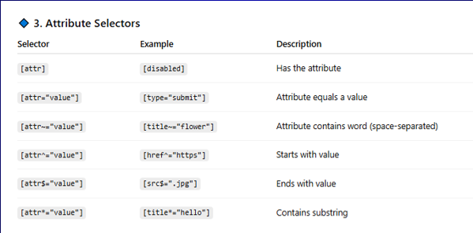
Attribute Selectors

Slide 15
Pseudo classes
selectors

Slide 16
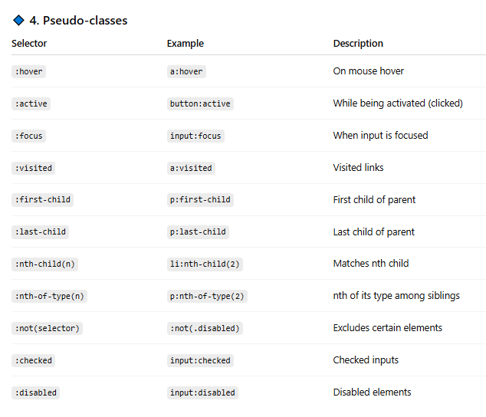
Pseudo-classes

Slide 17
Pseudo-elements
selectors

Slide 18
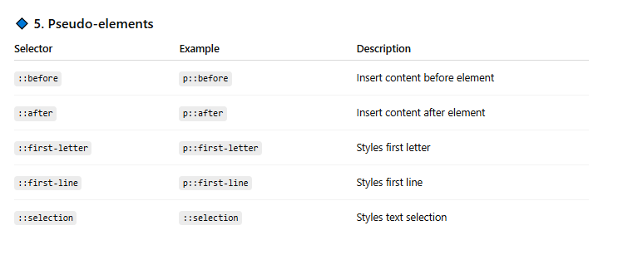
Pseudo-Elements

Slide 19
Yourturn1 - PartB

Slide 20
CSS Inheritance and css units

Slide 21
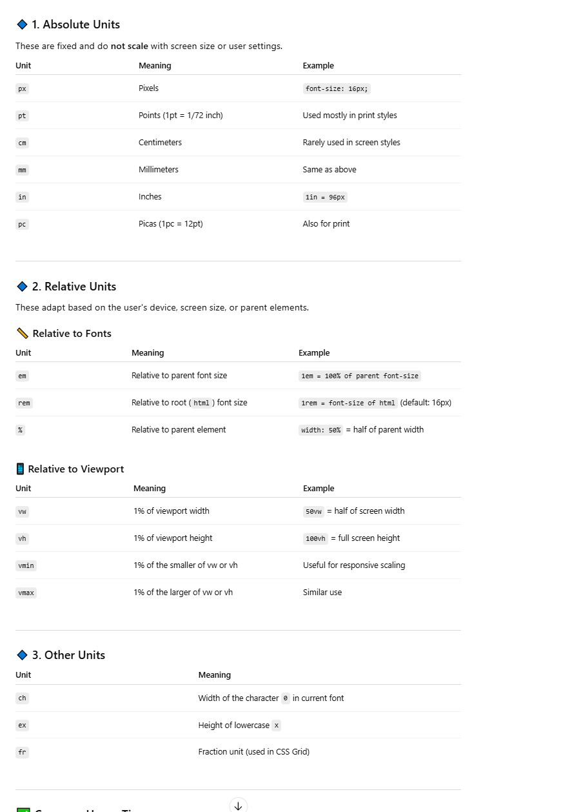
CSS units

Slide 22
CSS units

Slide 23
CSS units

Slide 24
CSS Inheritance
Some things inherit, some things don’t
You can force something to inherit with ‘inherit’
You can force something not to inherit with initial (use the initial html value) or by overriding.

Slide 25
When Rules collide!
What happens when we write two rule-sets that both want to act on a particular element in our html?
How do we know which on wins???

Slide 26
Figuring out the order of precedence!
The rule-set with the most specificity wins over rule-sets with less specificity
When two rule sets tie, the rule set closest to the html wins
Inline (in the actual html tag) rulesets beat everything, except…
!important!

Slide 27
Who wins the Specificity Award?
Class, pseudo-class, attribute
Elements/
pseudo-elements
Important!
Style attribute
ID
0
0
0
0
0
Largest number wins!
Tie goes to the rule closest to the tag

Slide 28
p
Class, pseudo-class, attribute
Elements/
pseudo-elements
Important!
Style attribute
ID
?
?
?
?
?
Largest number wins!
Tie goes to the rule closest to the tag

Slide 29
p
Class, pseudo-class, attribute
Elements/
pseudo-elements
Important!
Style attribute
ID
0
0
0
0
1
Largest number wins!
Tie goes to the rule closest to the tag

Slide 30
Article div p
Class, pseudo-class, attribute
Elements/
pseudo-elements
Important!
Style attribute
ID
?
?
?
?
?
Largest number wins!
Tie goes to the rule closest to the tag

Slide 31
Article div p
Class, pseudo-class, attribute
Elements/
pseudo-elements
Important!
Style attribute
ID
0
0
0
0
3
Largest number wins!
Tie goes to the rule closest to the tag

Slide 32
.myclass
Class, pseudo-class, attribute
Elements/
pseudo-elements
Important!
Style attribute
ID
?
?
?
?
?
Largest number wins!
Tie goes to the rule closest to the tag

Slide 33
.myclass
Class, pseudo-class, attribute
Elements/
pseudo-elements
Important!
Style attribute
ID
0
0
0
1
0
Largest number wins!
Tie goes to the rule closest to the tag

Slide 34
#myid
Class, pseudo-class, attribute
Elements/
pseudo-elements
Important!
Style attribute
ID
?
?
?
?
?
Largest number wins!
Tie goes to the rule closest to the tag

Slide 35
#myid
Class, pseudo-class, attribute
Elements/
pseudo-elements
Important!
Style attribute
ID
0
0
1
0
0
Largest number wins!
Tie goes to the rule closest to the tag

Slide 36
#myID div
Class, pseudo-class, attribute
Elements/
pseudo-elements
Important!
Style attribute
ID
?
?
?
?
?
Largest number wins!
Tie goes to the rule closest to the tag

Slide 37
#myID div
Class, pseudo-class, attribute
Elements/
pseudo-elements
Important!
Style attribute
ID
0
0
1
0
1
Largest number wins!
Tie goes to the rule closest to the tag

Slide 38
<p style=“color: green”
Class, pseudo-class, attribute
Elements/
pseudo-elements
Important!
Style attribute
ID
?
?
?
?
?
Largest number wins!
Tie goes to the rule closest to the tag

Slide 39
<p style=“color: green”
Class, pseudo-class, attribute
Elements/
pseudo-elements
Important!
Style attribute
ID
?
1
0
0
0
Largest number wins!
Tie goes to the rule closest to the tag

Slide 40
Let’s try some
Specicifity

Slide 41

A bit of fun

Slide 42
IC8

